Slide 1

DriverPass
System Analysis
Cristiano Miranda
Notes:
[No speaker notes required for this slide.]

Slide 2

System Requirements
Functional Requirements
  System shall connect users to the data and information they desire to study for their driver test.
  System shall authorize users’ roles to validate their ability to perform specific actions.
Nonfunctional Requirements
  System must run on any platform that has access to a web browser and an internet connection.
  System must require a user to enter a password and a valid two-factor authentication code to log in.
Notes:
The system has various requirements that must be met for it to function correctly. These requirements will range in degree, such as hardware, software, accessibility, and security requirements, but the two broad categories are functional and nonfunctional requirements. In this case, the listed functional requirements describe two of the most important functions the system must perform to operate and achieve the goals listed by DriverPass. The system needs to provide users with the information they need to study for their driver's test, as the primary goal of this project is to provide study material to help them prepare. The other functional requirement is that the system must validate a user's role or authority before they perform a specific action, as this is crucial to ensuring that users purchase the appropriate packages before they can access certain site features. Additionally, this function is essential to ensuring that only DriverPass employees or DriverPass administrators have access to sensitive information on the site, such as user data, to further DriverPass's goal of maintaining a secure site.
The other requirements, the nonfunctional requirements, are arguably as important as functional requirements within the system, as these specify specific requirements as to how the system will perform the functions housed within it. For this project, the primary nonfunctional requirements involve accessibility and security, as DriverPass's main concerns were enabling anyone to study for their driver's test and ensuring user security while using the site. First, the system needs to be accessible on any platform with a web browser, so any user can access the site and benefit from what it offers. The second involves ensuring the system has multiple security layers to increase protection for user accounts, thereby reducing risks when users use the system.

Slide 3
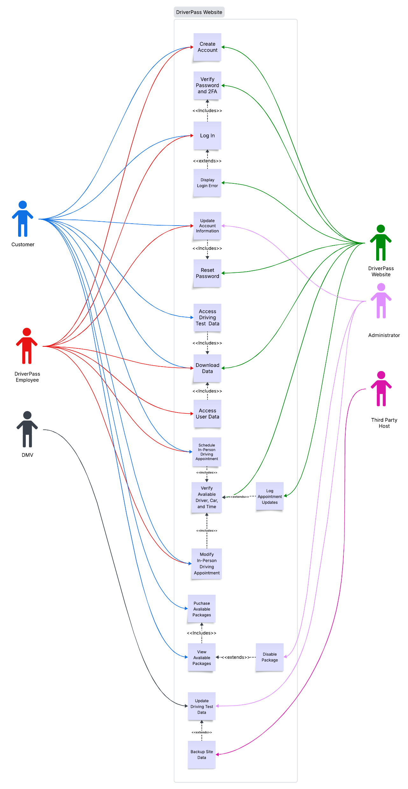
Use Case Diagram
Notes:
In this system, there will be multiple user types that perform different functions. These users are the customer, DriverPass employees, the DMV, the DriverPass website, administrators, and the third-party host that will be hosting the server. These six users will all perform different functions within the system, with some user types performing similar functions while others will be exclusive to specific user types. Having these exclusivity and user-type requirements for some functions will help ensure DriverPass's goal of restricting specific actions to authorized users, thereby improving the site's security. Specifying multiple specific users helps ensure that the various roles are individually defined, making it easier to determine which functions of the system each user can perform.
The functions listed in the use case diagram all contribute to enabling the system to achieve DriverPass's primary goals: providing users with the information they need to practice for their driving tests and giving them the chance to gain in-person driving experience. Various functions, such as providing users with the data they need and facilitating the scheduling and modification of in-person driving appointments, help the system achieve these primary goals. Still, secondary goals, such as staying up to date with information on the DMV's website and allowing users to download and export data, are also included, as these features help to improve upon the primary goals by allowing users to access the most up-to-date information about driving and view specific information offline. To accomplish this, functions such as notifying authorized users of any changes to the DMV's site allow them to update the site's information quickly. Additional features are also available within the system to make repeated use more convenient through the implementation of specific functions. Functions such as user account creation, account logins, and account information modification allow users to associate an account with themselves, providing continuous access to their information on the site and enabling them to modify it until they are satisfied. Again, these functions help improve the primary goals by making it easier for users to continue accessing their study material. Finally, one of the system's last functions is to log changes, providing a record that helps improve and maintain data consistency and site security.

Slide 4
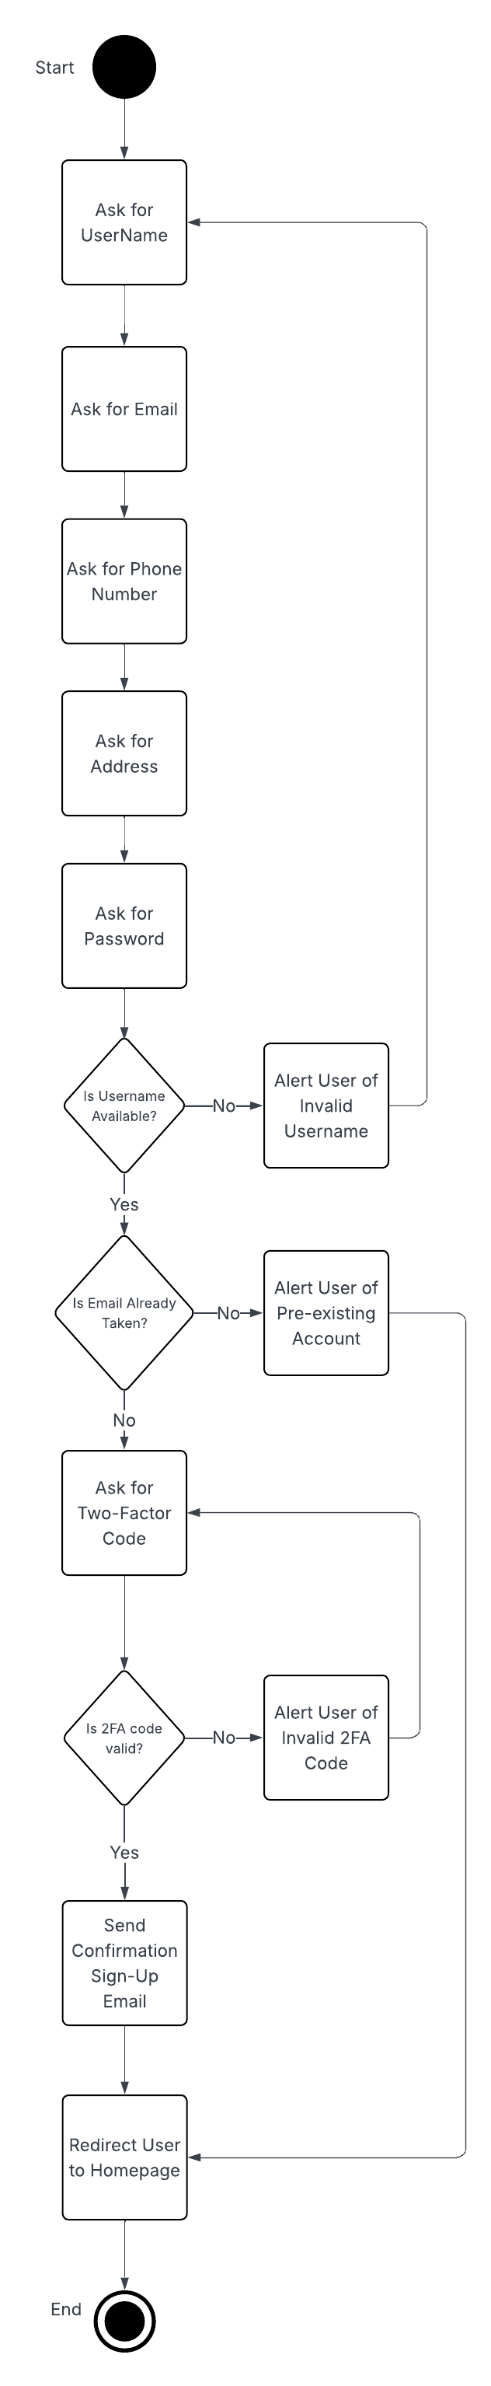
Activity
Diagram
Notes:
This activity diagram describes the process of a user registering their account on the site. There are multiple steps in this process, and the total number varies depending on the results of specific actions or the information entered. While the first couple of steps are consistent, with them being asking for the user's username, email, phone number, address, and finally password, the next step leads to a divergence. The system will check whether the user-entered username is available. If it is not, the process will alert the user to an invalid username and then repeat the first step so they can retry registering their information, which is an important step in ensuring this site is easy to sign up for. In contrast, if the username is available, the process proceeds to the next potential divergence: checking the user's email for availability. Again, if it is not available, the user is alerted; however, this time, they are informed that the email is associated with an account. Then they are redirected to the homepage, and the process ends. However, if the email is available, the system then asks for a two-factor authentication code. Another divergence occurs here, with the first path being if the entered code is invalid, the user is alerted, and the system asks for a two-factor authentication code again. For the other path, if the code is valid, the process proceeds to the next step: sending a confirmation email to the user. Finally, the last step occurs, in which the user is redirected to the homepage, and the process ends.
Various steps and checks throughout this process are added to ensure DriverPass's goal of providing customers with an easy-to-use, helpful site is met. Performing these checks, such as validating a username and email address availability within the system, helps DriverPass maintain an easy-to-use site. Additionally, specific steps such as alerting users about invalid usernames, emails, or two-factor authentication codes help make it easier to understand what is causing the error or issue within the process. Finally, the decision to allow the user to continue the process and repeat necessary steps, rather than ending it, makes registration easier and less of a hassle, rather than requiring the user to restart the process and the registration form every time an issue occurs.

Slide 5
Security
System will require both a password and valid two-factor authentication code for a user to log in.
System will require users to connect to the site via HTTPS to secure the connection.
System will freeze or lock any account associated with a “brute force” hacking attempt once the issue is identified
System will allow users to rest their password using their account’s associated email address.
Notes:
User security is arguably one of the most important factors for any company, as failing to secure users who access the site can create a poor view of the company and its product in the long run. Thus, security is at the forefront of this system to ensure that any user who uses it does not become compromised, such as unauthorized users accessing their accounts or stealing their sensitive information while using this site. In this system, user accounts are protected from malicious users by adding multiple security checks to verify a user's identity before they gain access to the system and log in. These additional layers require all users to provide multiple forms of identification before they can log in, including a password and a two-factor authentication code generated by an external app. While passwords are commonly used, they can be easy to crack, leaving an account vulnerable. To strengthen account security, two-factor authentication requires the user to enter an additional code that changes frequently. Without access to the two-factor authentication generator, guessing this code would be nearly impossible, especially since its value changes every 30 seconds or so.
Still, if an account is compromised and the associated user loses access, the system provides an additional way to retrieve the account via a password reset. Adding this recovery process will help users maintain access to their accounts even if a malicious user attempts to lock them out. By using the account's associated email to request a password reset, the user can reset their password and regain access to their account without losing their information or any purchases they had previously made.
Another important security point for users is that the system must ensure that any data sent to or received from the user is secure and inaccessible to malicious users. Data in transit can create security issues, as it would be easy for a malicious user to intercept it and compromise it. To prevent this issue, the system requires establishing a secure channel to the user by implementing the industry-standard HTTPS protocol to serve the user the website. Using HTTPS creates a secure tunnel that only the user and server can use to connect, blocking any traffic or possible interception from outside sources.
Additionally, malicious users may attempt to attack the system, making it essential to include mechanisms that enable the system to protect itself so that users can continue using the site without fear of it going offline. To accomplish this, the system will be able to lock specific user accounts to prevent them from accessing the system and continuing their malicious attack. Adding these features will allow users to continue accessing the system even in the event of an attack, and will enable administrators to see who was involved.

Slide 6
System Limitations
System will be inaccessible if the hosting server goes offline.
System will be unusable for users who do not have internet access.
Only ten cars are available at a given time for in-person driving appointments
The number of available cars will limit the number of packages available for purchase.
Notes:
A lot of effort was made to carefully design the system so that it could operate correctly and achieve the goals the client required; however, as with all systems, it has certain limitations. By far, the most noteworthy limitation is that the system relies heavily on the hardware and software that host it. Thus, if the system's host server goes offline, there will be no potential way for any user to access the system until the host server gets back online. Similarly, if any user attempts to access the system without a valid internet connection, they will be unable to do so. While the system benefits from being hosted online, in that it is accessible from anywhere in the world, it comes at the cost of potential issues with the system going offline and requiring users to have an internet connection to access it.
Other limitations stem from the client's limited number of resources. Given their limited resources, only a limited number of in-person driving appointments can be scheduled simultaneously because the client has a set number of cars available. Additional time considerations, such as travel time to an appointment, maintenance time, and work hours, also introduce time constraints that limit the number of in-person driving appointments that can occur at any given time, reducing the number of customers the system can accommodate. This limitation also ties into the fact that the number of cars will limit the number of packages available for purchase, as the client will need to maintain a set number of customers to avoid overbooking their driving appointments.

